Slide 1
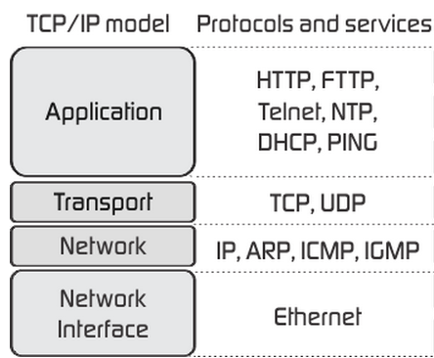
TCP/IP Model and Protocols
Frank Walsh
Sept 2023
This Photo by Unknown Author is licensed under CC BY-SA

Slide 2

Agenda
What’s a protocol suite/stack
TCP/IP and the benefits of “Layered Model”
Data Encapsulation
Accessing resources/data on a network
Logical addresses and Data Link (physical) addresses

Slide 3

Computer Network Protocols
An agreed convention for communication between devices
Formally defined and unambiguous
Network Protocols define the methods and data formats that devices send and receive the data.
.

Slide 4


Protocol Suites & Standards
A Protocol Suite is a group of protocols designed to work together
Typically use open, widely used protocols.
Example: Wifi, HTTP, FTP, TCP, IP...
Protocol Standards established by Institute of Electrical and Electronics Engineers (IEEE) or the Internet Engineering Task Force (IETF)
Protocol suites based on open standards ensures that products from different manufacturers can work together for efficient communications
An iPhone can connect to and access the same website that an android or laptop can
This Photo by Unknown Author is licensed under CC BY-SA

Slide 5
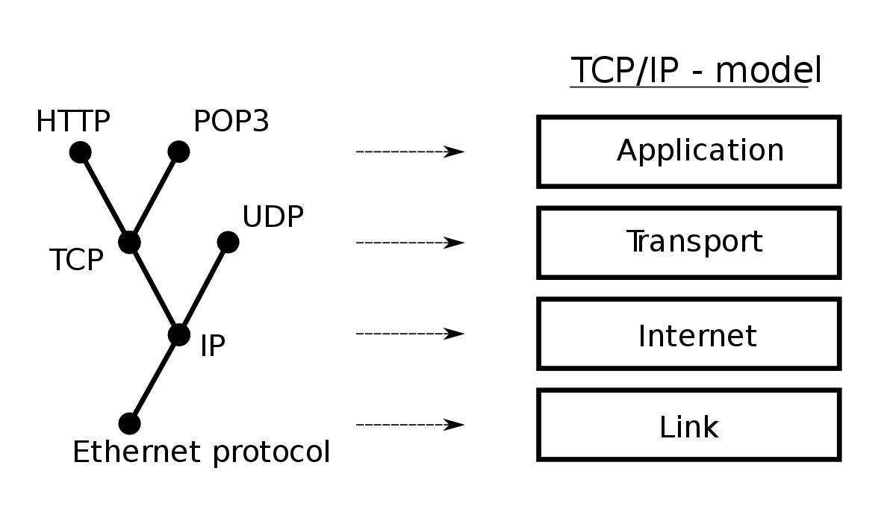
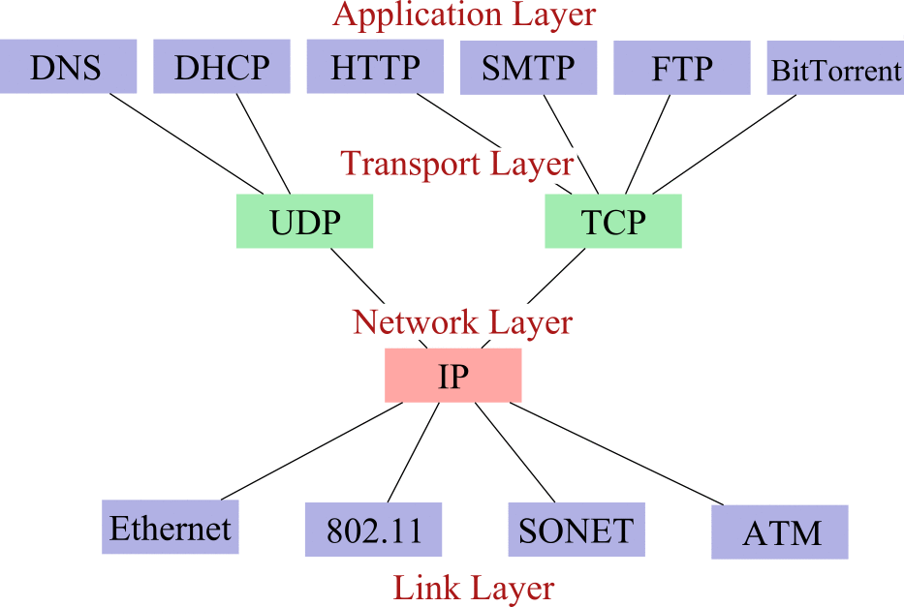
TCP/IP Protocol Suite
Often referred to as TCP/IP, TCPIP, or just IP
A whole suite of protocols, including TCP, IP, UDP, ARP, DNS, HTTP, ICMP and many more acronyms!
TCP originally developed by the US Department of Defense for wartime comms.
Remember ARPA from last lecture!
TCP/IP is now the “standard” protocol suite for the internet

Slide 6
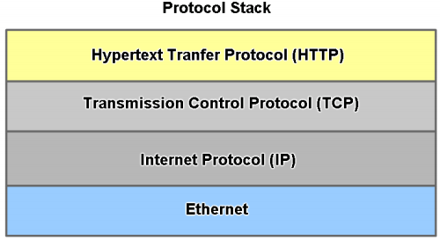
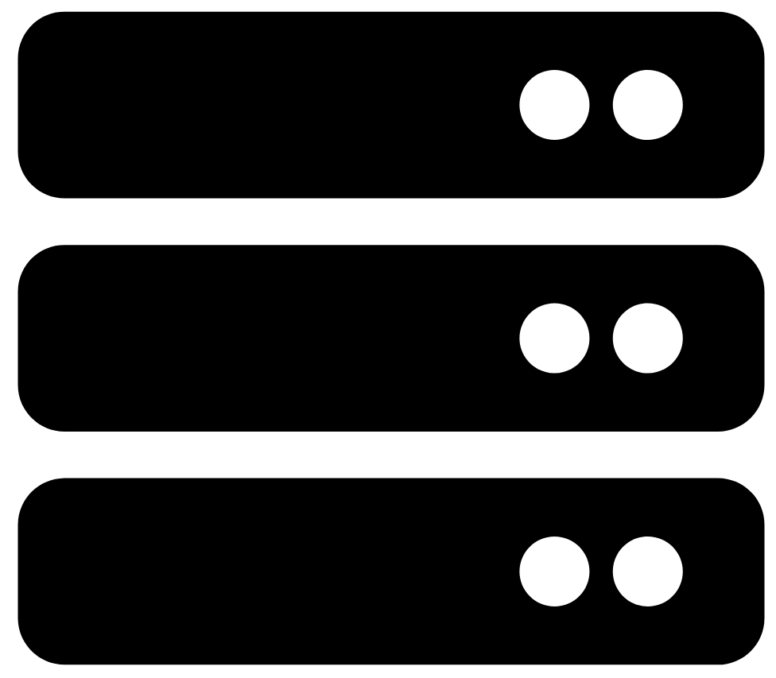
Example: Layered Model Network Comms
Layers
Web Server
Application
Transport
Network/ Internet
Data Link/ Physical
Benefits of Layered Model:
assists in protocol design
fosters competition
changes in one layer do not affect other layers
provides a common language
The Layered approach breaks down the communication process into smaller and easier to handle interdependent categories, with each solving an important and distinct aspect of the data exchange process.
Notes:
(HTTP) is an application-layer protocol for transmitting hypermedia documents, such as HTML..
(TCP) As each application creates a stream data to be sent to a remote application, this data must be prepared to be sent across the media in manageable pieces. The Transport layer protocols describe services that segment this data from the Application layer. This includes the encapsulation required on each piece of data. Each piece of application data requires headers to be added at the Transport layer to indicate to which communication it is associated.
(IP): for routing and addressing packets of data so that they can travel across networks and arrive at the correct destination
(Ethernet): family of wired computer networking technologies commonly used in local area networks. Used for delivering frames from one network interface card (NIC) to another NIC on the same network
Layering the communications process means breaking down the communication process into smaller and easier to handle interdependent categories, with each solving an important and somehow distinct aspect of the data exchange process.

Slide 7
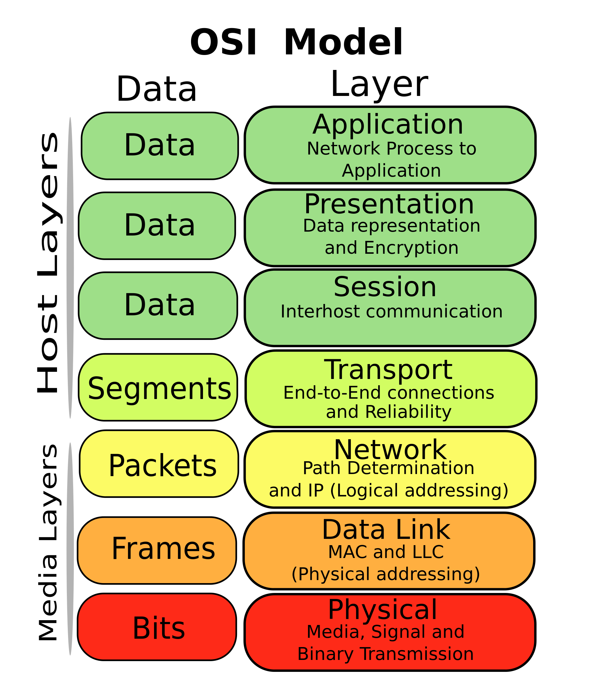
OSI Model
Open Systems Interconnection(OSI) introduced by the International Organization for Standardization (ISO) in 1984
Provide a reference model to make sure products of different vendors would interoperate in networks.
A layer in the OSI model communicates with three other layers:
the layer above it, the layer below it, and the same layer at its communication partner.
Image Source: https://upload.wikimedia.org/wikipedia/commons/thumb/4/47/Osi-model-jb.svg/2000px-Osi-model-jb.svg.png

Slide 8
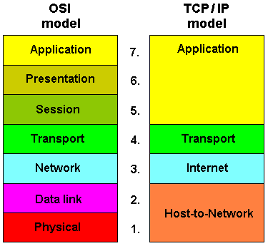
OSI vs TCP/IP
TCP/IP model combines the presentation and session layer into its application layer.
TCP/IP combines the OSI data link and physical layers into the host-to-network/network access layer
Internet developed on around TCP/IP protocols.
Thus very popular.... Networks are not usually built on the OSI model, even though the OSI model is used as a guide.
(Data Link/Physical)

Slide 9


Comms in TCP/IP: Data Encapsulation
Large File
Data
Data
Data
User Data
Segment Header
Data
TCP Segment
Network Header
Segment Header
Data
IP Packet
Frame Header
Network Header
Segment Header
Data
Frame Trailer
Ethernet Frame
(Data Link/Physical)
010001010101010011111010100111011011100101010101110….
Notes:
Encapsulation is the process where protocols add their information to the data.
At each stage of the process, a PDU has a different name to reflect its new functions.
There is no universal naming convention for PDUs, in this course, the PDUs are named according to the protocols of the TCP/IP suite.
PDUs passing down the stack are as follows:
Data (Data Stream)
Segment
Packet
Frame
Bits (Bit Stream)

Slide 10
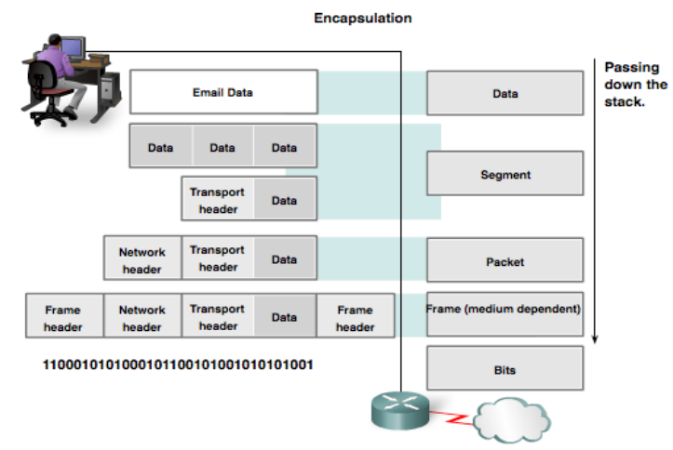
Data Encapsulation: Protocol Data Units (PDUs)
Image: cisco.com
Notes:
Next slide, working up from the bottom…

Slide 11
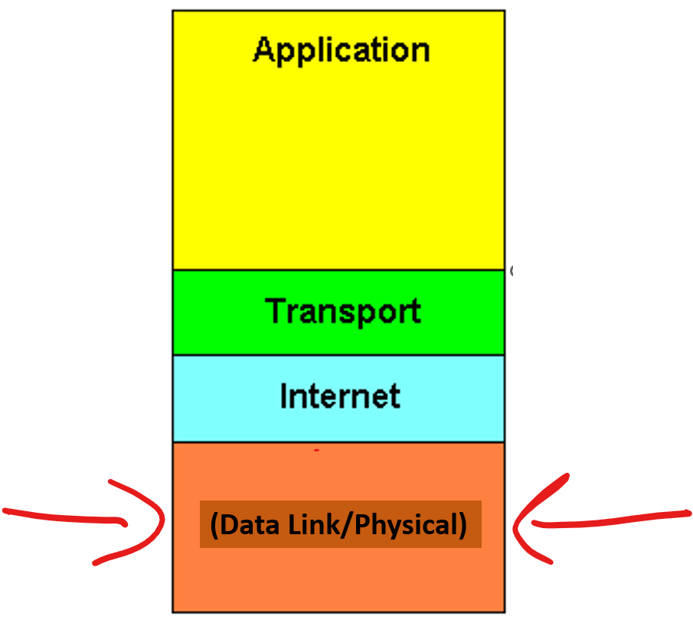
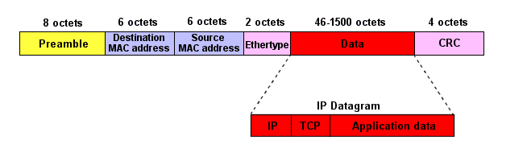
TCP/IP Layers - Data Link/Physical
Defines how data is sent physically through the network, including how it's framed and how devices are addressed.
Data Link Layer protocols transfer data between nodes on a network segment across the physical layer.
Supported by many physical layer implementations
Wireless/wired
PDU is the frame
Sequence of alternating 1s and 0s for synchronisation
Unique 6 octet (48 bit) address. “hardware” or “physical” address
Value used to check accidental changes to raw data. Calculated at both ends using data. Received value should match calculated value…
This Photo by Unknown Author is licensed under CC BY-SA

Slide 12
TCP/IP Layers - Internet/Network Layer
Internet/Network layer protocols primary function is to move data from one network to another network
Network addresses(IP Addresses) must have a mechanism to locate hosts on different networks
Intermediary network devices such as routers, decapsulate frames to read destination host address contained in the packet header.
Routers use the network portion of this address to determine which path to use to reach its destination.
IP/Network Packet
Destination IP Address
Source IP Address
Data
Network
Device
Network
Device

Slide 13
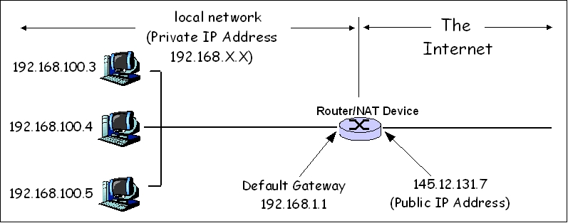
TCP/IP Layers – Internet/Network IP Addresses
IP addresses are “logical”
Can be assigned to a device
Includes network identification and Host identification
Each device on a network must have a unique IP address
Public IP addresses for the internet assigned by a central authority (IANA)
Private IP addresses are reserve for internal use behind routers/Network address translation(NAT) devices.
This Photo by Unknown Author is licensed under CC BY-SA

Slide 14
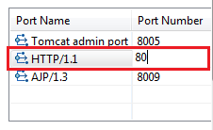
TCP/IP Layers - Transport Layer
Transport layer protocols describe services that segment data from the Application layer.
How does a computer with one network interface differentiate between different services?
Port Numbers are used in the transport layer to represent applications or services
When a device receives data, the port number is used to determine which app or process is the correct destination
There are generally accepted port numbers:
What’s the port for SSH service?
HTTP service?
FTP service?
This Photo by Unknown Author is licensed under CC BY-SA
Notes:
As each application creates a stream data to be sent to a remote application, this data must be prepared to be sent across the media in manageable pieces. The Transport layer protocols describe services that segment this data from the Application layer. This includes the encapsulation required on each piece of data. Each piece of application data requires headers to be added at the Transport layer to indicate to which communication it is associated.

Slide 15
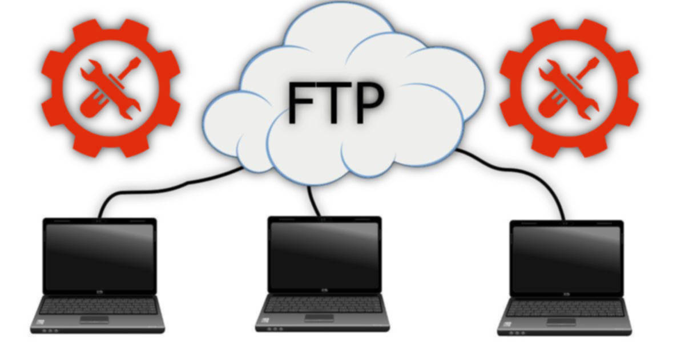
TCP/IP Layers – Application Layer
Represents high-level data exchange between applications
Application services, data formatting, encryption, and dialog control can happen at Application layer
User interfaces and application-level processes reside here.
This Photo by Unknown Author is licensed under CC BY

Slide 16
Accessing Resources on a Network
Using TCP/IP protocol stack

Slide 17
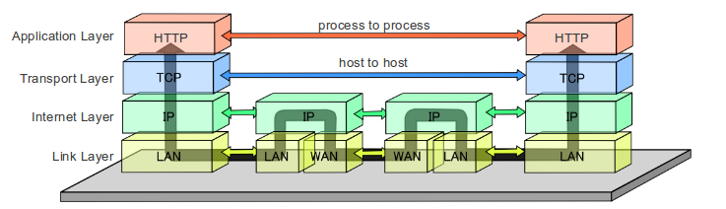
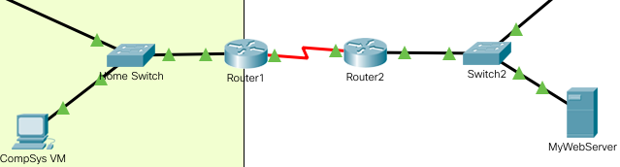
Example of Layered Model: Accessing Web Page…
Layered Model
Logical Topology
Compsys VM
Router1
Router2
MyWebServer
Packet Tracer Example File on Website
This Photo by Unknown Author is licensed under CC BY-SA

Slide 18
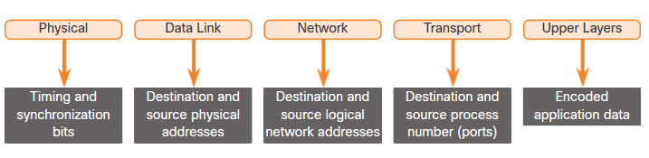
Network Addressing
The data link and network layers use addressing to deliver data from source to destination.
Network layer source and destination addresses - Responsible for delivering the IP packet from original source to the final destination.
Data link layer source and destination addresses – Responsible for delivering the data link frame from one network interface card (NIC) to another NIC on the same network.
Notes:
3 – Protocols and Models
3.7 – Data Access
3.7.1 – Addresses

Slide 19
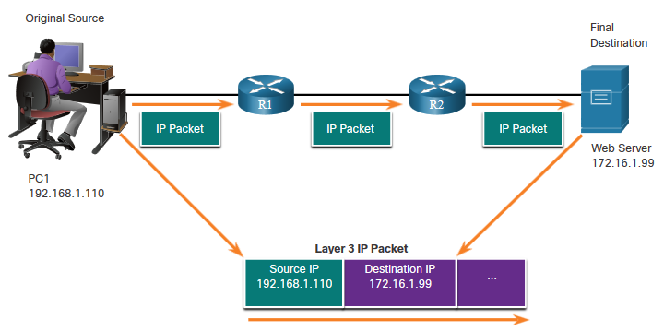
Network Layer: Logical Address
The IP packet contains two IP addresses:
Source IP address - The IP address of the sending device, original source of the packet.
Destination IP address - The IP address of the receiving device, final destination of the packet.
These addresses may be on the same network or on different networks.
Notes:
3 – Protocols and Models
3.7 – Data Access
3.7.2 – Layer 3 Logical Address

Slide 20
Network Layer: Logical Address (Cont.)
An IP address contains two parts:
Network portion
The left-most part of the address indicates the network which the IP address is a member.
Each network will have the same network portion.
Host portion
The remaining part of the address identifies a specific device within the network.
This portion is unique for each device on the network.
Notes:
3 – Protocols and Models
3.7 – Data Access
3.7.2 – Layer 3 Logical Address (Cont.)

Slide 21
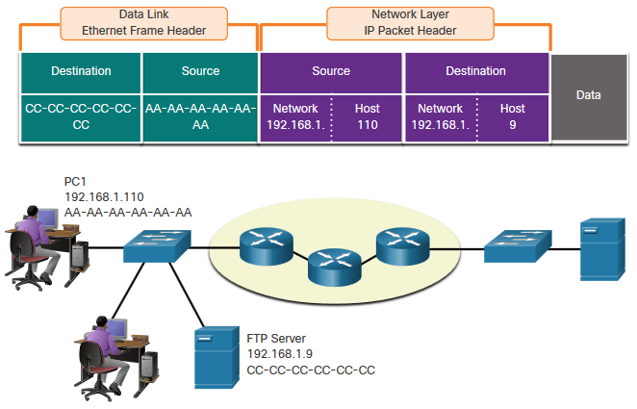
Devices on the Same Network
When devices are on the same network the source and destination will have the same number in network portion of the address.
PC1 – 192.168.1.110
FTP Server – 192.168.1.9
Notes:
3 – Protocols and Models
3.7 – Data Access
3.7.3 – Devices on the Same Network-

Slide 22
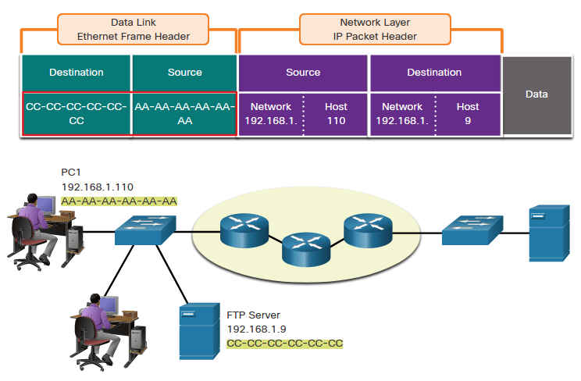
Data Link Layer Addresses: Same IP Network
When devices are on the same Ethernet network the data link frame will use the actual MAC address of the destination.
MAC addresses are embedded into the Ethernet Adapters and are local addressing.
The Source MAC address will be that of the sending device.
The Destination MAC address will always be on the same network as the source, even if the ultimate destination is on a remote Network.
Notes:
3 – Protocols and Models
3.7 – Data Access
3.7.4 – Role of the Data Link Layer Addresses: Same IP Network

Slide 23
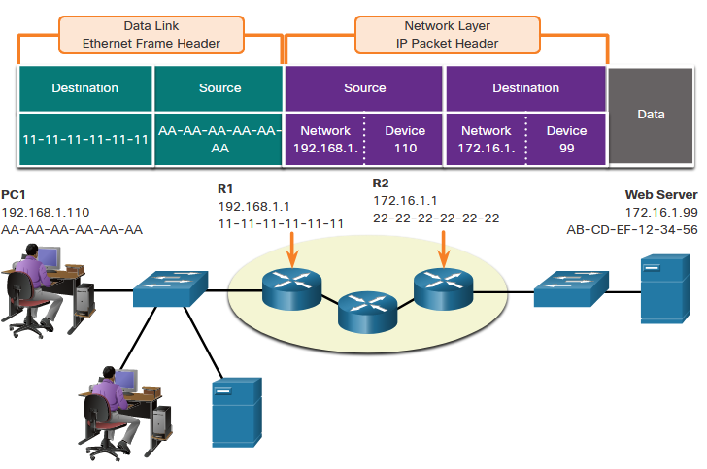
Devices on a Remote Network
When the source and destination have a different network portion, this means they are on different networks.
PC1 – 192.168.1
Web Server – 172.16.1
Notes:
3 – Protocols and Models
3.7 – Data Access
3.7.6 – Role of the Network Layer Addresses

Slide 24
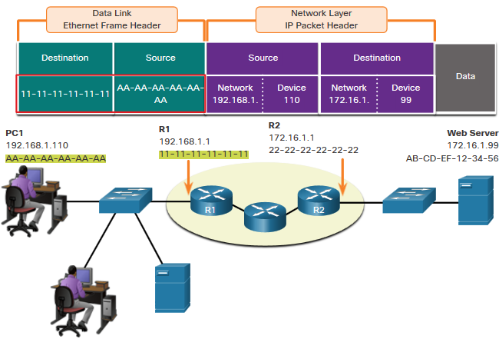
Role of the Data Link Layer Addresses: Different IP Networks
When the final destination is remote, Network Layer(Layer 3) will provide Data Link Layer(Layer 2) with the local default gateway IP address, also known as the router address.
The default gateway (DGW) is the router interface IP address that is part of this LAN and will be the “door” or “gateway” to all other remote locations.
All devices on the LAN must be told about this address or their traffic will be confined to the LAN only.
Once Layer 2 on PC1 forwards to the default gateway (Router), the router then can start the routing process of getting the information to actual destination.
Notes:
3 – Protocols and Models
3.7 – Data Access
3.7.7 – Role of the Data Link Layer Addresses: Different IP Networks

Slide 25
Role of the Data Link Layer Addresses: Different IP Networks (Cont.)
The data link addressing is local addressing so it will have a source and destination for each link.
The MAC addressing for the first segment is :
Source – AA-AA-AA-AA-AA-AA (PC1) Sends the frame.
Destination – 11-11-11-11-11-11 (R1- Default Gateway MAC) Receives the frame.
Note: While the L2 local addressing will change from link to link or hop to hop, the L3 addressing remains the same.
Notes:
3 – Protocols and Models
3.7 – Data Access
3.7.7 – Role of the Data Link Layer Addresses: Different IP Networks (Cont.)

Slide 26
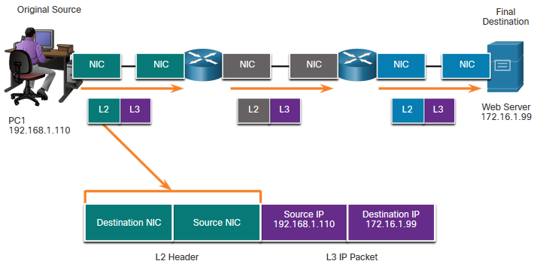
Data Link Addresses
Since data link addressing is local addressing, it will have a source and destination for each segment or hop of the journey to the destination.
The MAC addressing for the first segment is:
Source – (PC1 NIC) sends frame
Destination – (First Router- DGW interface) receives frame
Notes:
3 – Protocols and Models
3.7 – Data Access
3.7.8 – Data Link Addresses

Slide 27
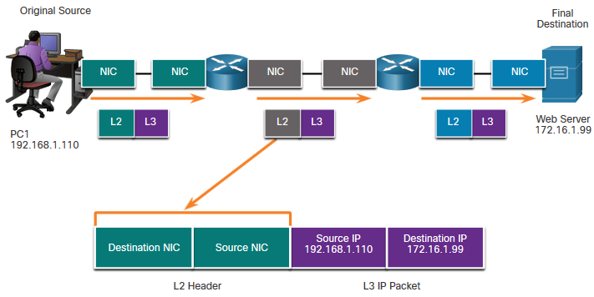
Data Link Addresses (Cont.)
The MAC addressing for the second hop is:
Source – (First Router- exit interface) sends frame
Destination – (Second Router) receives frame
Notes:
3 – Protocols and Models
3.7 – Data Access
3.7.8 – Data Link Addresses (Cont.)

Slide 28
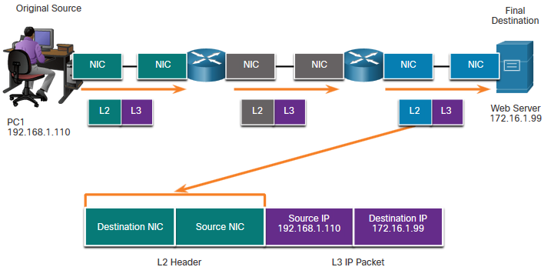
Data Link Addresses (Cont.)
The MAC addressing for the last segment is:
Source – (Second Router- exit interface) sends frame
Destination – (Web Server NIC) receives frame
Notes:
3 – Protocols and Models
3.7 – Data Access
3.7.8 – Data Link Addresses (Cont.)

Slide 29
Data Access Data Link Addresses (Cont.)
Notice that the packet is not modified, but the frame is changed, therefore the L3 IP addressing does not change from segment to segment like the L2 MAC addressing.
The L3 addressing remains the same since it is global and the ultimate destination is still the Web Server.
Notes:
3 – Protocols and Models
3.7 – Data Access
3.7.8 – Data Link Addresses (Cont.)

Slide 30
Quiz
Which of the following devices operate primarily at the Data Link Layer(OSI Layer 2)
Router
Web Server
Switch
Laptop
Which of the following statements are True for communication between different networks (ie across the internet)
The source and destination MAC addresses will remain the same from link to link
The destination IP address will change from link to link.
The source and destination MAC address will change from link to link/hop to hop
The destination IP address will remain the same across all links.

Slide 31

Break

